Slide 1
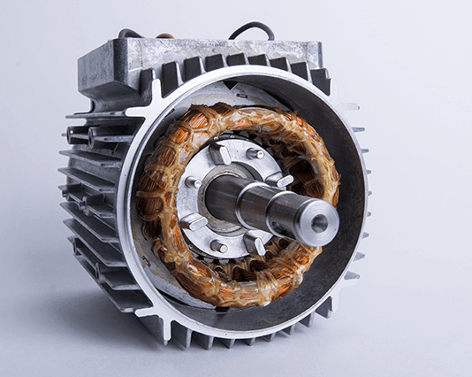
Three Phase Motor Crane Control System
Presented by: Arshia Keshvari

Slide 2
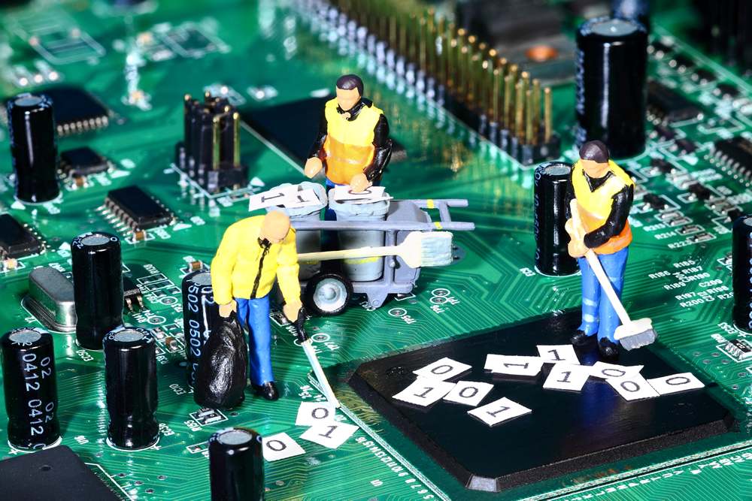
Introduction
Project Overview: PWM-based three-phase motor control system for cranes.
Key Objectives:
Design and Implement full motor control circuit (start/stop, direction, speed, braking)
Develop PWM control mechanism
Environmental monitoring and display
Simulation of practical crane motor operation

Slide 3
System Architecture
Power Stage
Control Stage
Monitoring & Display
Power electronics and supply
Main controller and drivers
Environmental monitoring and display

Slide 4
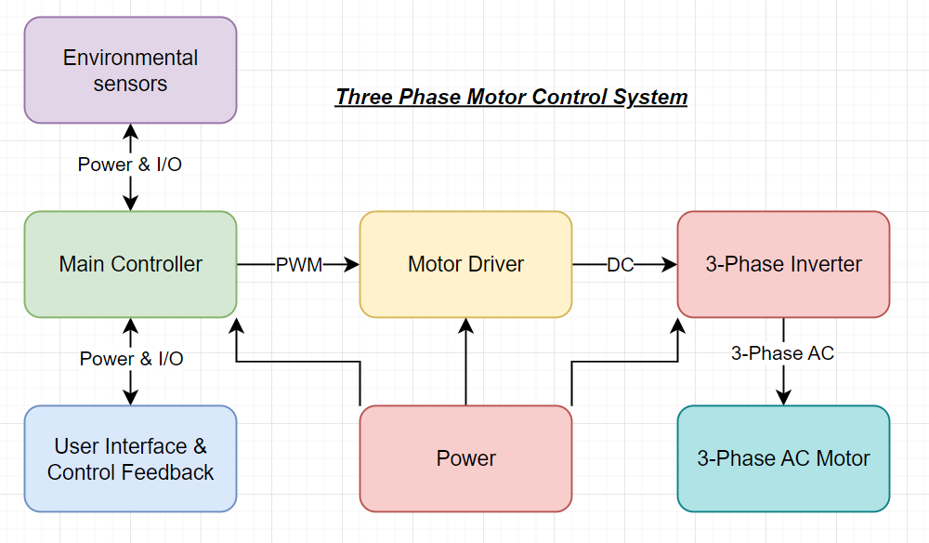
Block diagram

Slide 5
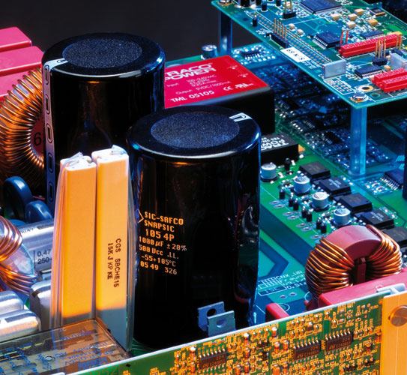
Power Electronics
MAINS 230VAC to 12VDC converter design
3-phase NMOS MOSFET inverter topology
LC filter design for output waveform smoothing
High power MOSFET IC driver

Slide 6
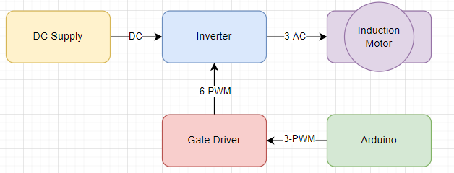
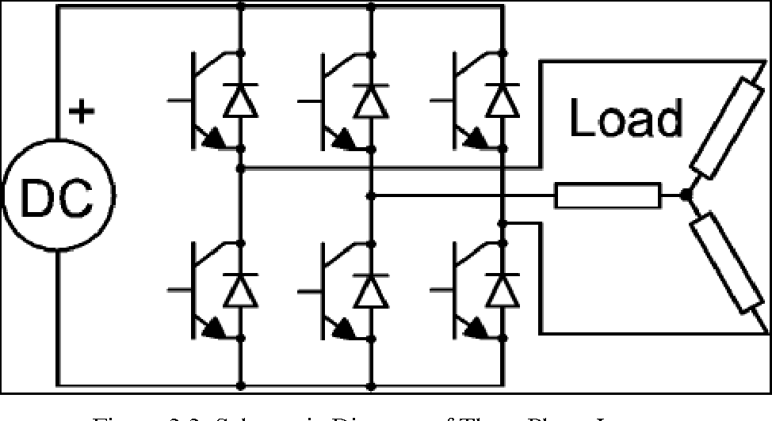
Control system Implementation
Arduino Nano as main logic controller
PWM generation algorithm
Sine wave technique
Dead-time insertion method
Motor control functions
Start/Stop, Forward/Reverse, Speed control, Braking logic

Slide 7
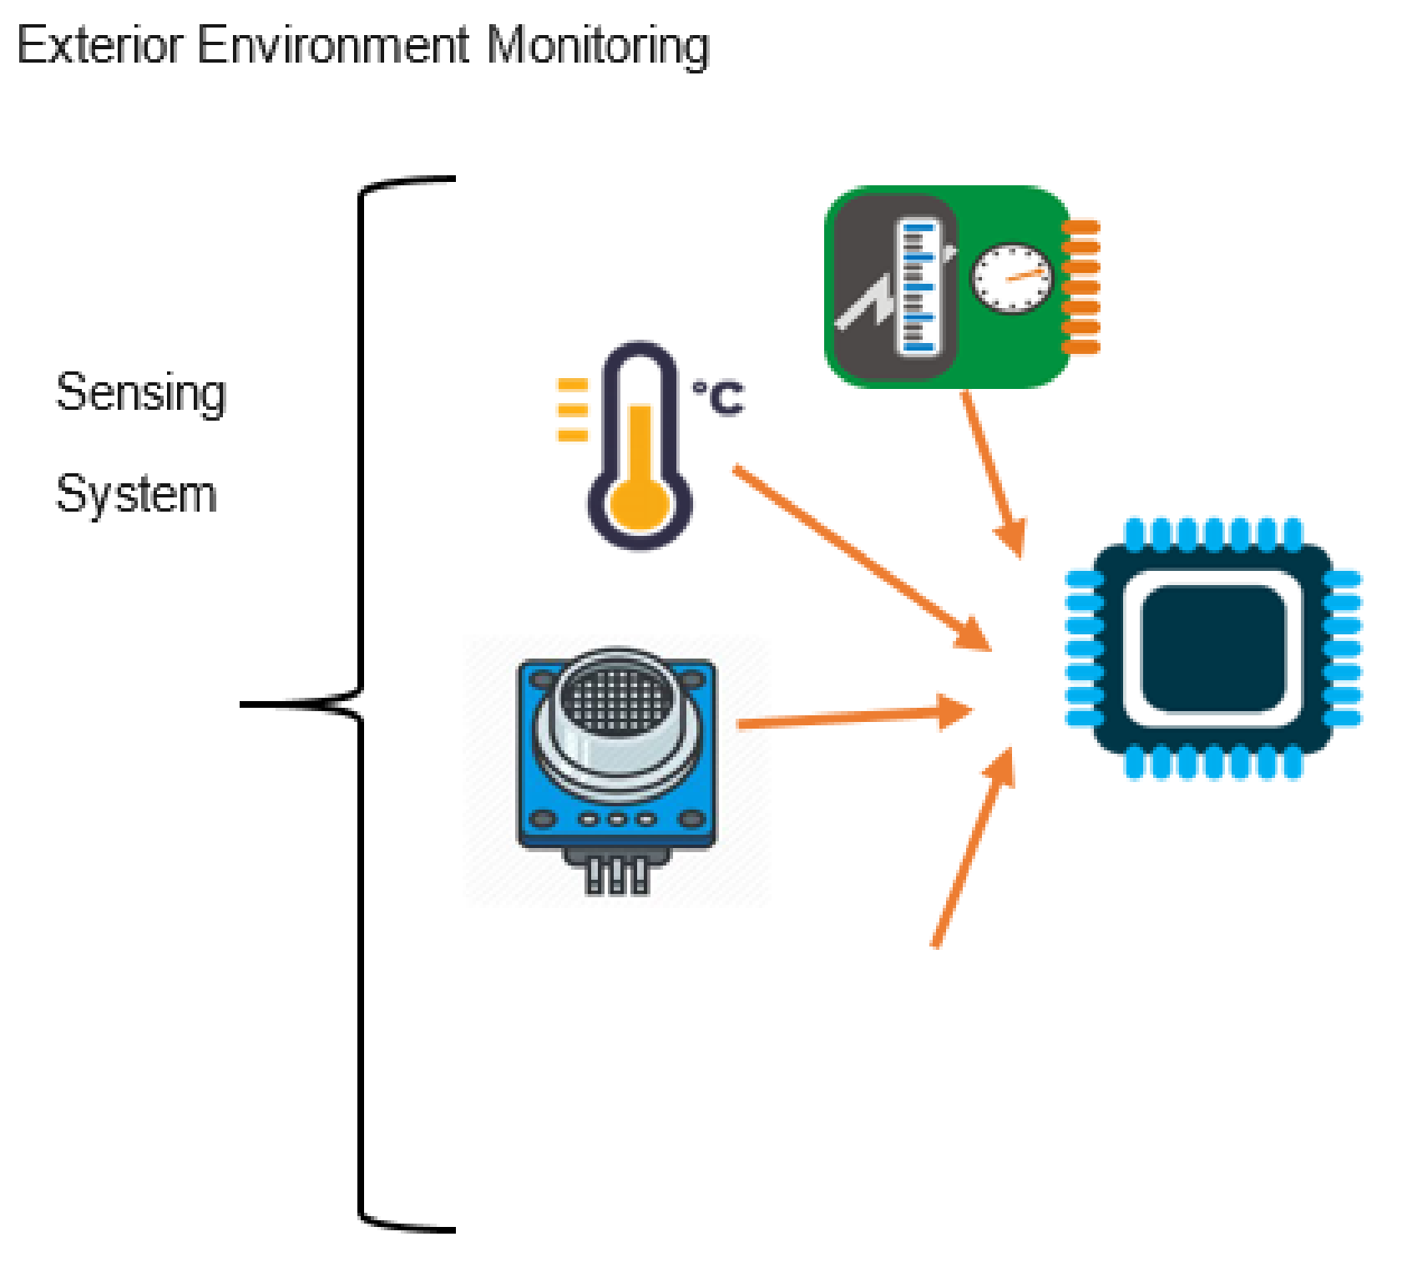
Environmental Monitoring
Arduino Uno for sensor management and display
Sensor integration and signal conditioning:
Speed estimation using electromechanical equations
Environmental sensors integration: Stress, Mass, Dust, Temperature, Humidity, Wind speed, Distance
Data processing and display update routines
Handling communication protocols using drivers

Slide 8
Electronic Schematic

Slide 9
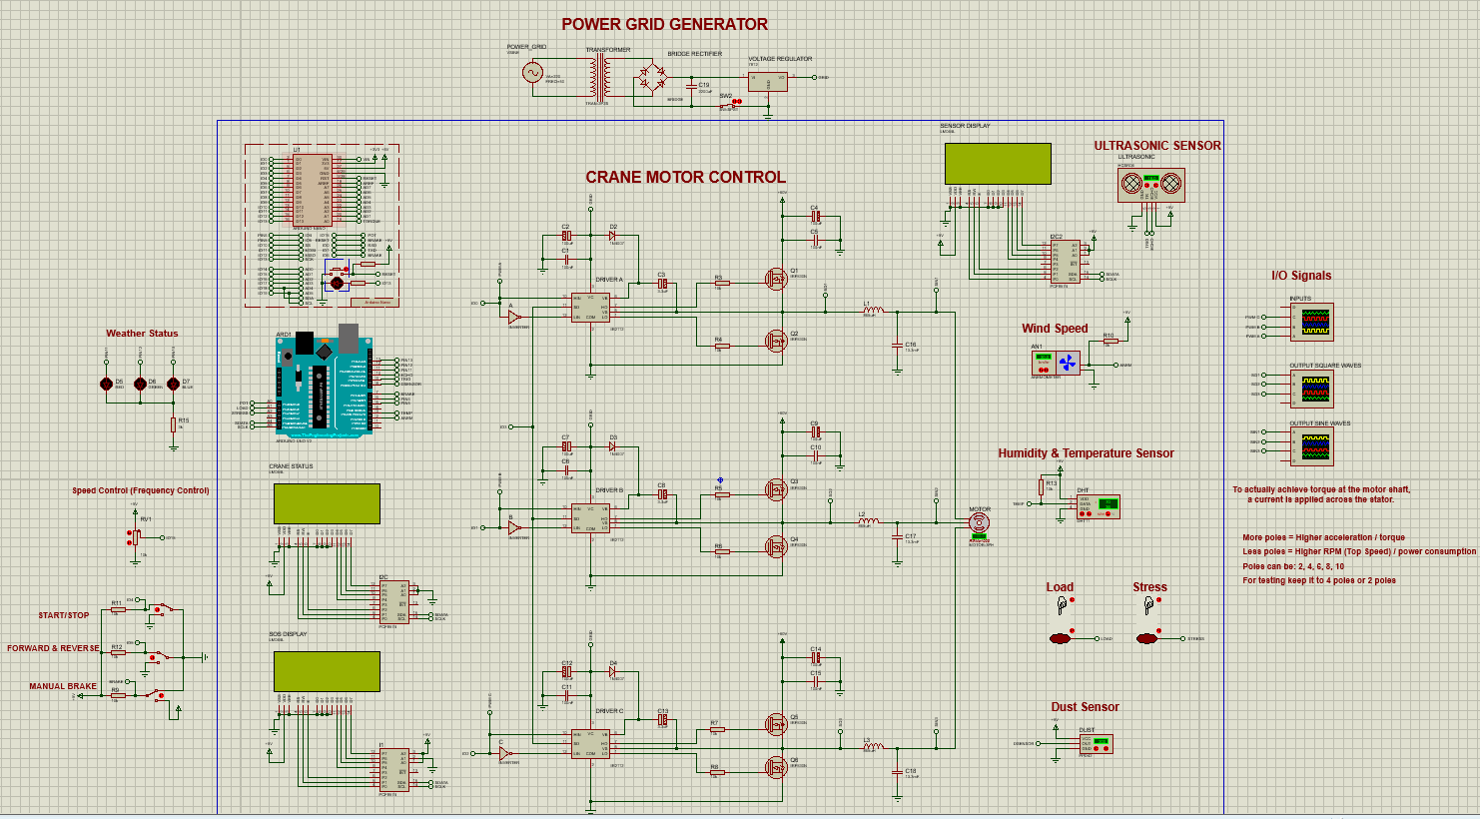

Slide 10
Simulation Analysis

Slide 11
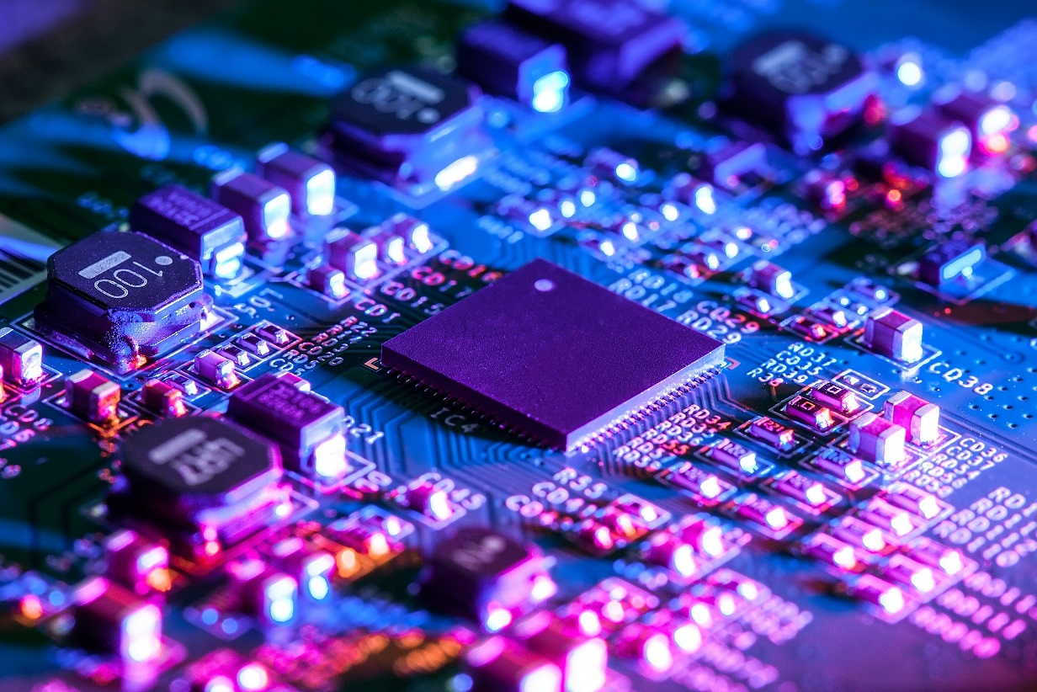
Challenges
Accurate PWM generation across the chain Solution: Troubleshooted timing configuration with respect to waveforms expected.
Minimizing noise, switching losses and EMI Solution: Implemented dead-time insertion, bypass caps and filtering segments.
Electrical parameters use theoretical estimation Solution: Efficient equations for speed, torque, and load power calculation of motor.

Slide 12
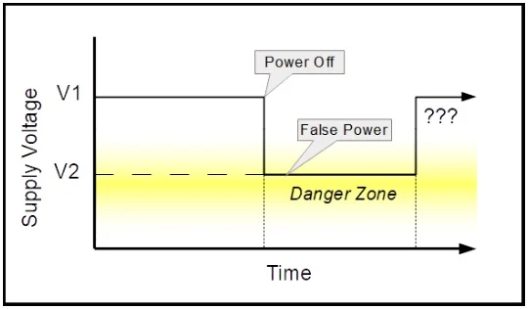
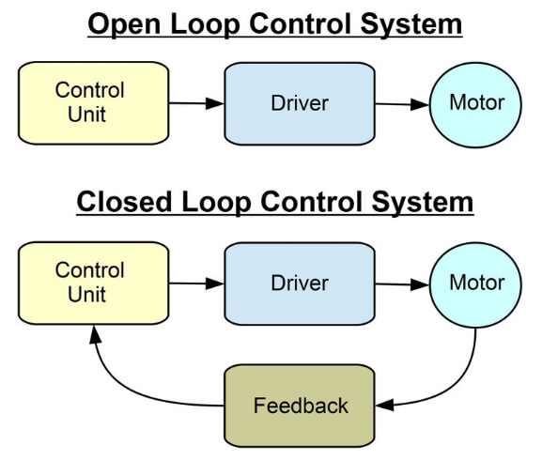
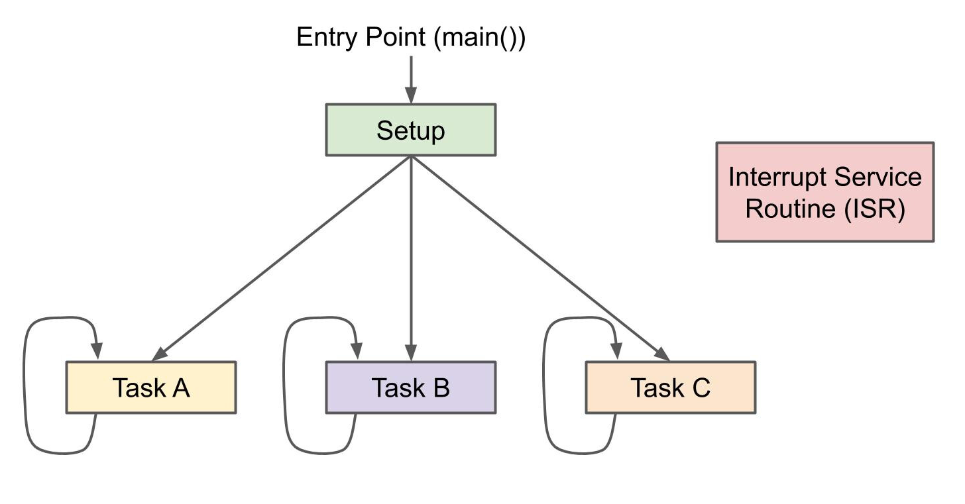
SUMMARY & IMPROVEMENTS
Design of a simple 3-phase motor drive and control system
Implementation of effective control and monitoring functions
Potential functional Improvements:
- Implementation of closed-loop motor feedback control techniques
- Voltage/Current monitoring, isolation and safety protection mechanisms
- Non-blocking functions to minimize delay and latency of computation

Slide 13

QUESTIONS

Slide 14
END

